Slide 1

Rainfall Weather forecast prediction report
Submitted by:
Nupriya Saxena
SciFor Technology
ID Number- MST03-0027
Under the guidance :-
Urooj khan mam

Slide 2
Introduction of RainFall Weather forecast
Weather forecasts are made by collecting data about the current state of the atmosphere and using an understanding of atmospheric processes to predict how the atmosphere will evolve.

Slide 3
Problem Statement
Weather forecasting is the application of science and technology to predict the conditions of the atmosphere for a given location and time. Weather forecasts are made by collecting quantitative data about the current state of the atmosphere at a given place and using meteorology to project how the atmosphere will change.
Rain Dataset is to predict whether or not it will rain tomorrow. The Dataset contains about 10 years of daily weather observations of different locations in Australia.

Slide 4
Data Sources and their formats
We already have a sample Dataset was in the format of CSV (Comma Separated Values).
We can do data model in two way
Weather model
Rainfall model

Slide 5
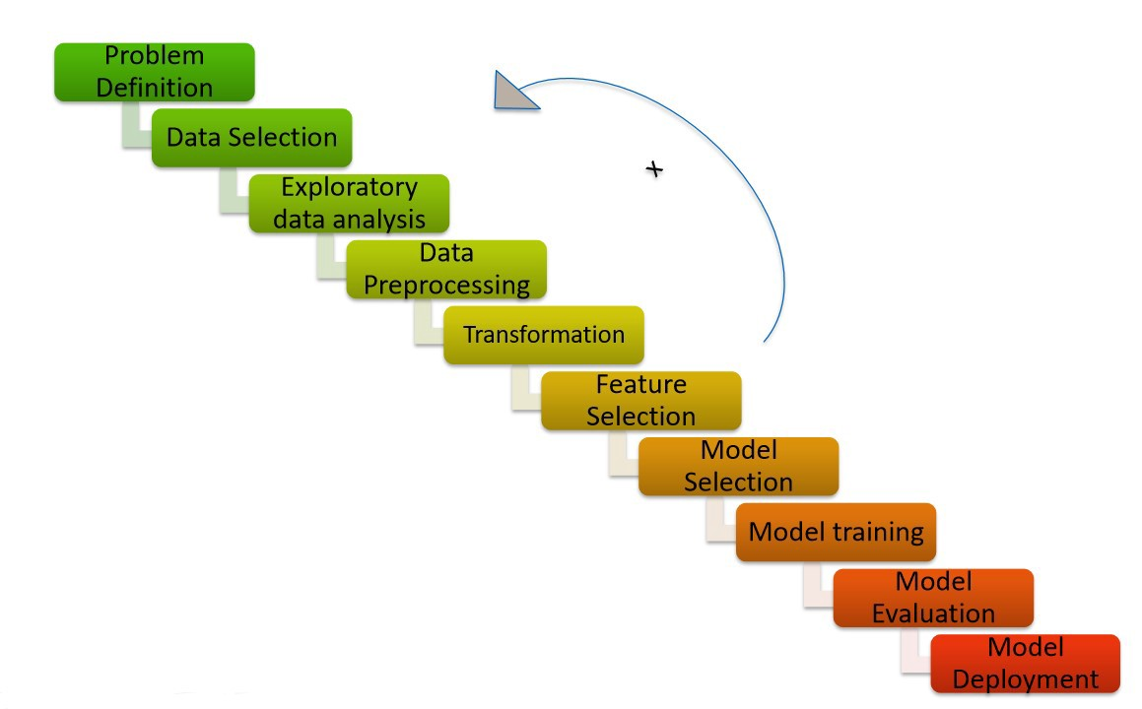
Project Flow Chart

Slide 6
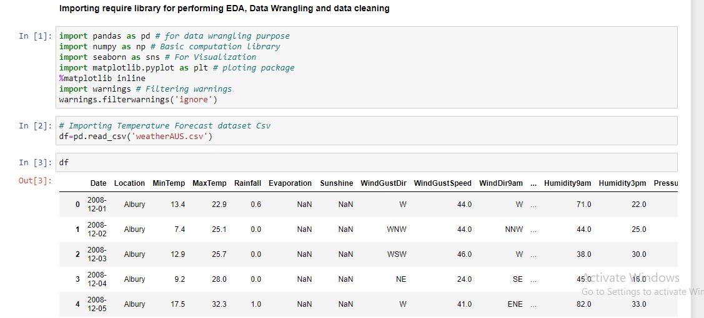
Import libraries which requires and

Slide 7
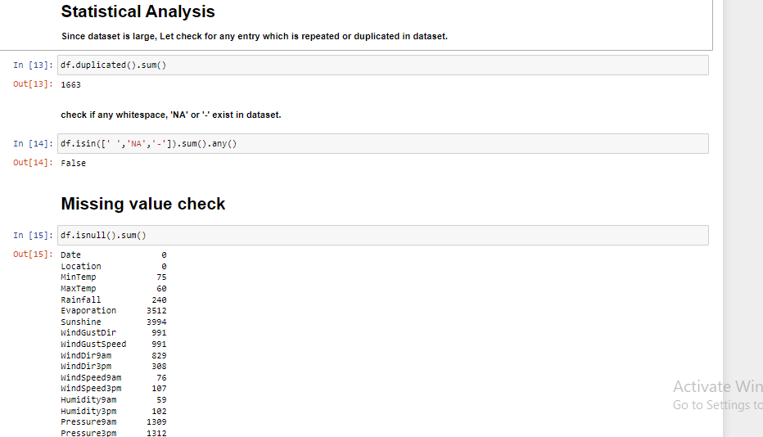
Then we do statstical analysis In which we check Duplicate value NA value Null value(missing value)

Slide 8
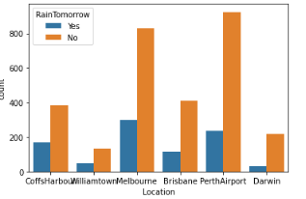
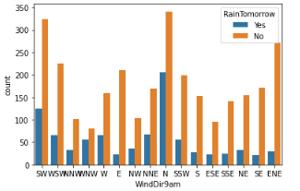
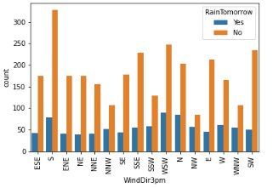
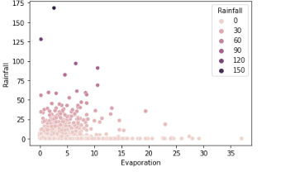
Data visualization

Slide 9
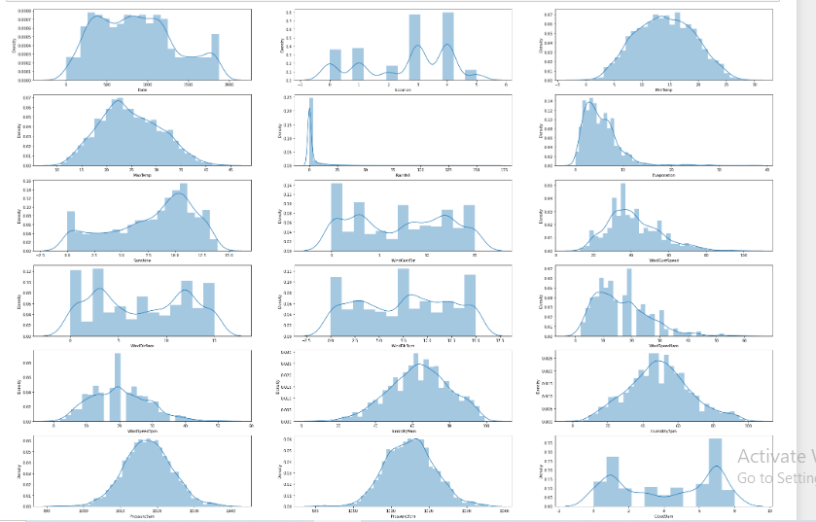
We define distribution of data in variable using pairplot

Slide 10
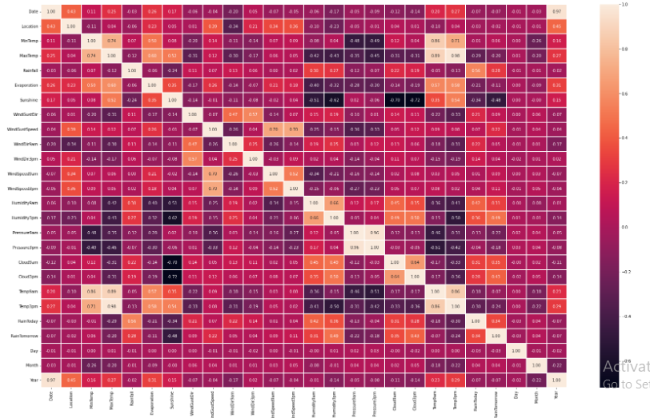
Data description using heatmap

Slide 11
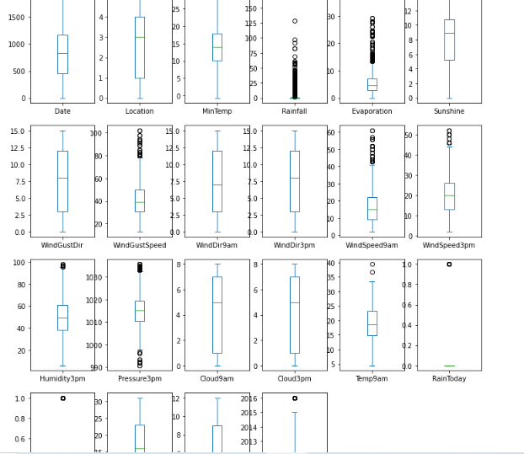
Find outliers using boxplot

Slide 12
Machine Learning Algorithm Used
The different regression algorithm used in this project to build ML model are as below:
KNeighbors classifier
logistic Regressor
Decision Tree classifier
Random forest classifier

Slide 13
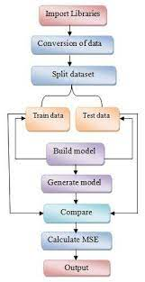
ML Model Building Flow
Standard Scaling of Data
Splitting Training Data Using test_train_split
Finding Best Random state
Training ML Model on Different Algorithms
5 Fold Cross Validation of Different Model
Selection of Best Model Based on Evaluation Criteria
Hyper Parameter Tuning of Best Model
Saving final Model Using Joblib
Predicating Test Dataset using Final Model

Slide 14
Key Findings and Conclusions of the Study
Weather forecast
Rainfall forecast
Final model | Accuracy score
RandomForestClassifier | 0.8973172987974098
Final model | Accuracy score
RandomForestRegressor | 0.947731729879741

Slide 15


